Slide 1
MEAN STACK DEVELOPER CAPSTONE PROJECT
Team Panthers

Slide 2
Team Panthers
Harshvardhan Sawal : Backend functionalities
Ian Haynes : Backend, Ticketing(User and Employee), requests(Employee and Admin), Update Product
Kranthi Kumar Reddy Anugu : Login and SignUp page functionalities, Documentation
Miguel Valdez : Backend, Update profile, Employee order status,Generate Reports
Lipi Boreddy : Frontend components, deployment

Slide 3
Functionality
We developed a dynamic website for online purchase of groceries with three main users for this application
ADMIN : As an admin, after successful login he/she has different functionalities like Add Products, Update Products, Delete Products, View Requests etc
USER: Users can login with existing details or create an account by clicking in signup
EMPLOYEE: The employee can sign-in entering the login credentials like email and password and have functionalities like Send Request,Update Order, Unlock Users etc

Slide 4
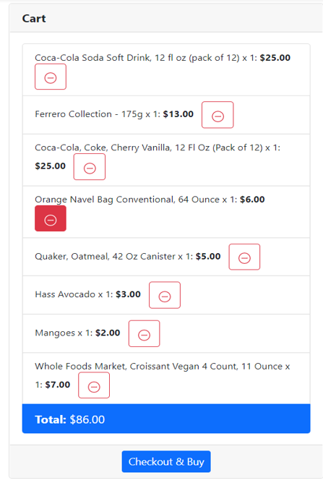
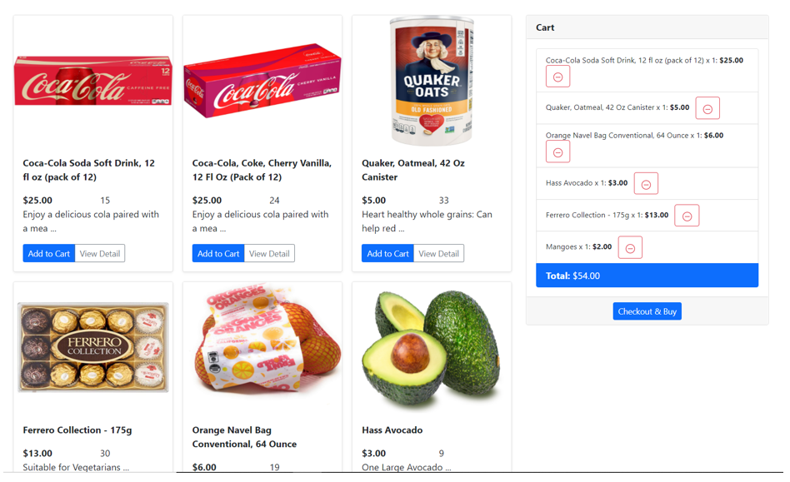
Demo This is how our Cart screen looks like

Slide 5

Challenges faced
Communication is a challenge for a virtual team as we didn’t have the opportunity to interact with eachother as frequently as a co-located team could.
We overcame this challenge by communicating with team members more often and by creating a Kanban board to keep track of the tasks completed and yet to complete.

Slide 6


Conclusion
We used Angular, Nodejs, MongoDB, Expressjs, Typescript, Bootstrap and AWS cloud for this application
We successfully designed the website with full functionality.

